Slide 1

SMART DEFENCE GLOVES FOR ARMY personals
LC_Boys

Slide 2
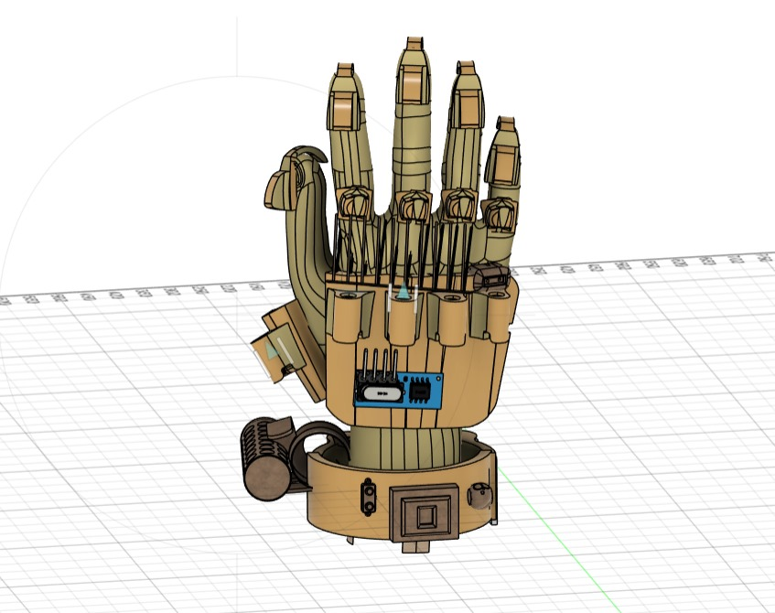
Features:
Chemical dispensing
Miniature explosive charges
Concealed blade (or) spikes
Environment monitoring
Medical monitoring
Navigation and way finding
Radio frequency jamming
Integrated stun technique
Blinding flashlights
Hook launching
Grenade launcher attachment
Impact enhanced grip & support
Covert surveillance capabilities

Slide 3
Chemical dispensing
Functionality : Adding a compartment for storing and dispensing chemical agents tear-gas, pepper spray.

Slide 4
Miniature explosive charges
Functionality : Include miniature explosive charges within the gloves for breaching doors, destroying obstacles, or creating distractions in tactical situations.

Slide 5
Concealed blade (or) spikes
Functionality : Equip the gloves with retractable blades or spikes for discrete and lethal close quarters combat engagement

Slide 6
Environment monitoring
Functionality : Include sensors to monitor environment conditions such as temperature, humidity, and air quality, enabling soldiers.

Slide 7
Medical monitoring
Functionality : Biometric sensors into the glove to monitor the soldiers vital signs and health stuffs providing early warnings.

Slide 8
Navigation and way finding
Functionality : Implement GPS navigation features to assist soldiers in navigating unfamiliar terrain and reaching designed objectives with precisions.

Slide 9
Radio frequency jamming
Functionality : An radio frequency jamming module in the gloves would be capable of limiting electromagnetic signals across a wide range of frequencies to interface with and disrupt enemy communications, radar system, and electronic devices in the radius.

Slide 10
Integrated stun technique
Functionality : Capable of delivering an electric shock upon contact with an enemy solider, temporarily incapaciting him.

Slide 11
Blinding flashlights
Functionality : Tactical flashlights are commonly used by military personnels for disorienting adversaries and providing illumination in low light conditions.

Slide 12
Hook launching
Functionality : A hook launcher can help in scaling targets like tall fences or guards posts or even mountains.

Slide 13
Grenade launcher attachment
Functionality : Design the glove with a modular attachment point for mounting and launching small grenades (or) explosive charges at targets gloves adjust the grenades according to there targets.

Slide 14
Impact enhanced grip & support

Slide 15
Covert surveillance capabilities
Functionality : Concealed cameras or microphones embedded in the gloves for conducting covert surveillance operations, gathering intelligence, and monitoring enemys.

